Slide 1
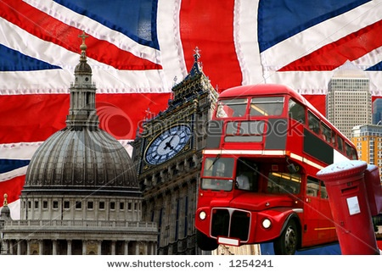
Britain in the world

Slide 2
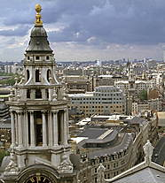
United Kingdom of Great Britain and Northern Ireland
The State in West Europe on British island.
Territory to England - 244000 kv.km
The Population to Britain - 59,4 mln. person- Englishwoman, Scotsman, Irishman.
The most Largest city - London, Portsmouth, Birmingham, Liverpool, Manchester, Sheffield.

Slide 3
Britain in the world
Britain attracts people from all over the world
Modern architecture in the City showing the American influence
International Derby horse races
BBC World Service Television broadcasts its programmers worldwide.

Slide 4
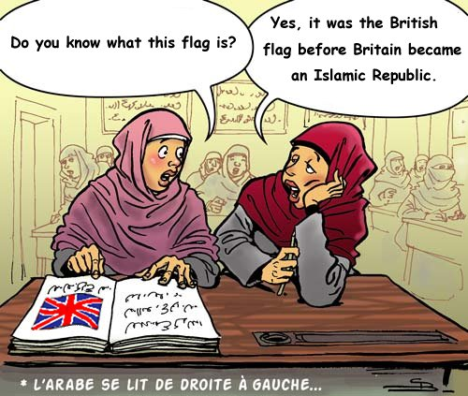

Slide 5
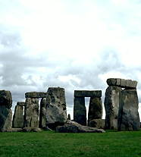
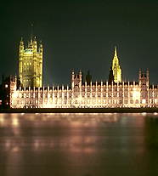
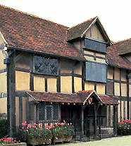
Sights
Stonehenge
Building of the parliament
House Shekspeare in Stratford

Slide 6
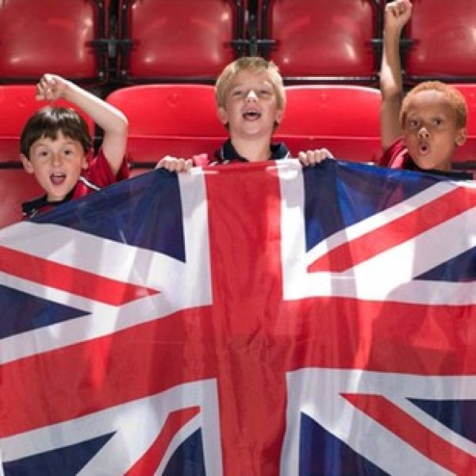
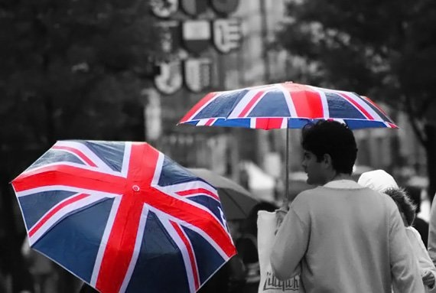

Slide 7
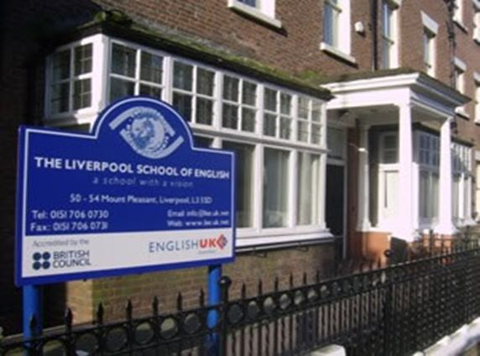
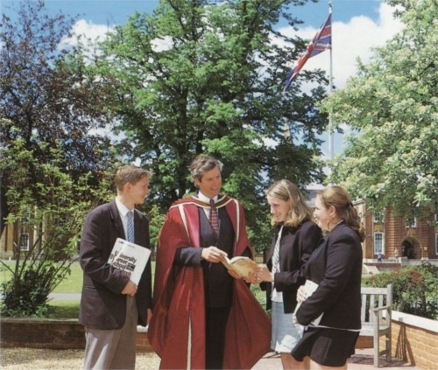
Famous Britain people
James Watt
John Logier Baird
Sir William Bragg
Sir Martin Pyle
Lord Rutherford
Professor Dorothy Hodgkin Sir Alexander Fleming
Lord Florey
James Watson

Slide 8
The End

